Slide 1
3d-Printed Granular Jamming Hand
Melissa Indoe
Chris Kang
Sean Phelan
Maggie Serra
Chris Wallace

Slide 2

Problem Statement
There are 3 million arm amputees worldwide
59% have amputations below the elbow
Current prosthetic hands are costly
Only half of arm amputees can afford prosthetic hands
People in developing countries cannot get access to such devices
There is a global need to develop affordable, readily available prosthetics

Slide 3

Project Objective
Create a “below-the-elbow” prosthetic hand
The hand is:
Open Source
Highly Affordable (Costing $363)
High-Functioning
Task-Oriented
Simple to Produce

Slide 4
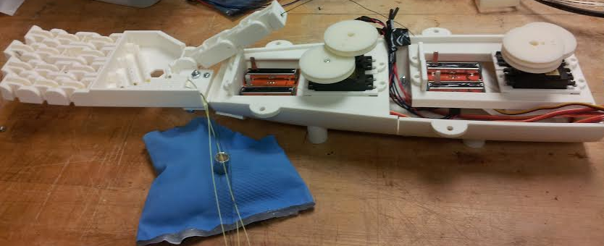
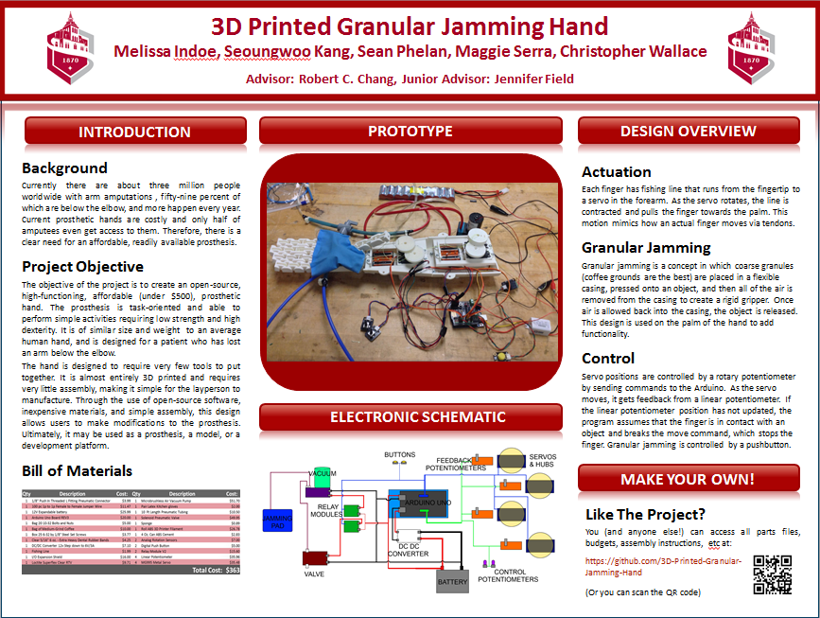
Deliverables
Completed Prototype
Hand
Granular Jamming Pad
Forearm
Electronics
Arduino Program
Website
SquareSpace: Project Information
Github: Downloadable Source Files
Team Poster

Slide 5
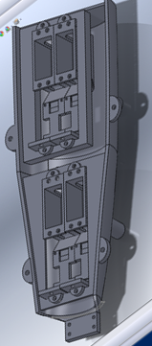
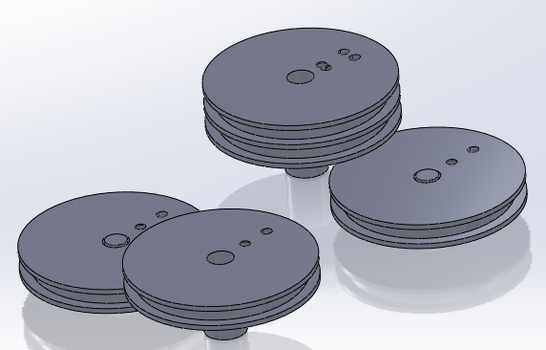
Device Design Overview
Hand Design
Forearm Design
Servo Hub Design
Granular Jamming Pad
Electronics and Programming

Slide 6
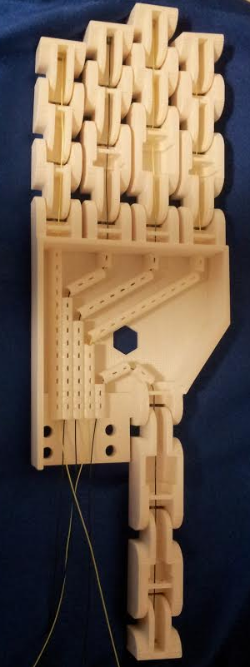
1. Hand Design
Matches size and weight of human hand as closely as possible
Thumb is mounted in opposition to middle finger
Actuated by cables
Fingers are held straight by dental rubber bands
First joint of each finger uses two rubber bands
All other joints use one rubber band

Slide 7
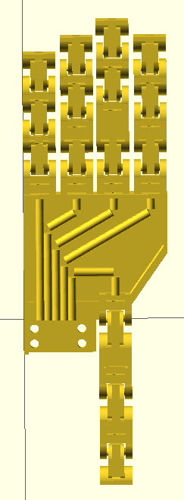
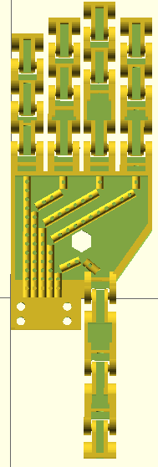
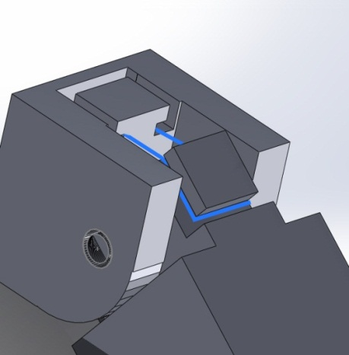
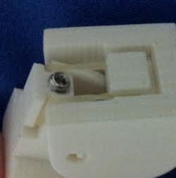
1. Hand Design
Design Updates:
Redesigned cable guides
U-shape for large contact area
Holes for support material removal
Updated routing for thumb
Hole for granular jamming fitting
Hexagonal to prevent rotation
Set screw support
Prevents hyperflexion
Creates more fluid motion
Old (left) and new (right) designs.
Bottom: Added set screw support.

Slide 8
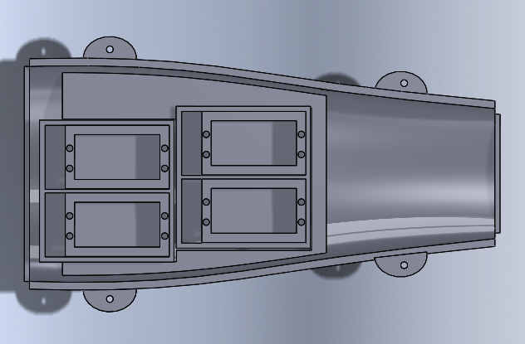
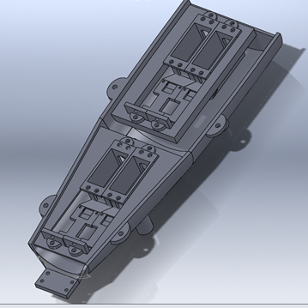
2. Forearm Design
Design Updates:
Motor mounts updated
Sensor mounts added
Hand mount has been moved to lower half of forearm
Forearm has been separated into segments for ease of printing
Arduino mount has been reduced in size
Top: Forearm design at the conclusion of phase 5.
Bottom: Final forearm design.

Slide 9
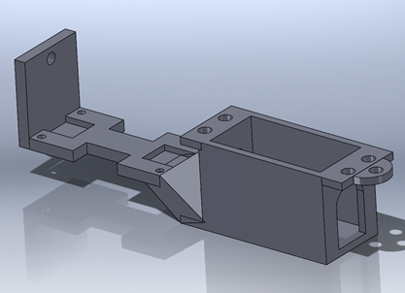
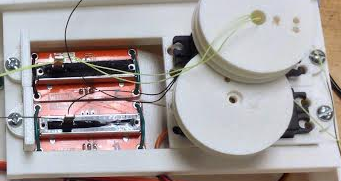
2. Forearm Design
Sensor and motor mount:
Hole for fishing line
Keeps fishing line level with potentiometer
Potentiometer mount
Insets for pins on both sides
Allows for forward/backward mounting
Depressions to protect solder points
Motor mount
Holes for wires on both sides
Allows for forward/backward mounting
Top: Sensor and motor mount model.
Bottom: Two assembled sensor and motor mounts.

Slide 10
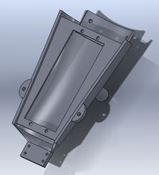
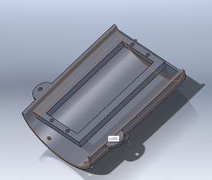
2. Forearm Design
Bottom Assembly:
Attachment points for:
Servo motors
Servo hubs
Potentiometers
Hand
Printed in two pieces
Accommodates print bed
Arm is 12 inches long
Print space available is 10x10x10 inches
Bottom forearm half segments (top) and fully assembled half forearm (bottom).

Slide 11
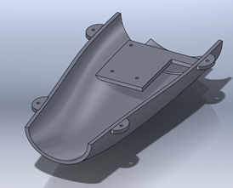
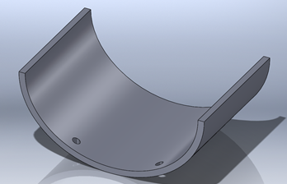
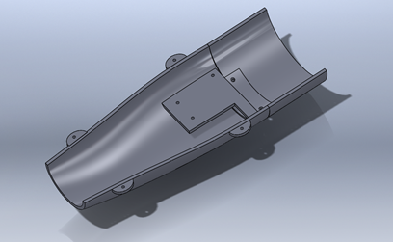
2. Forearm Design
Top assembly:
Attachment point for Arduino
Encloses forearm
Bolted to lower half of forearm at four points
Also could be sealed to lower half with ABS cement
Printed in two pieces
Top forearm half segments (top) and fully assembled half forearm (bottom).

Slide 12
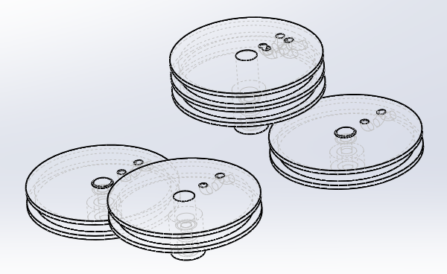
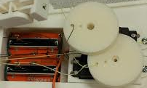
3. Servo Hub Design
Smallest diameter possible
Minimum diameter was calculated for desired range of motion
Staggered heights
Able to fit over and under each other within forearm housing
Fishing line tunnel
Fishing line is fed into tunnel and tied off at top of hub
This keeps line from sliding off flanges
Wireframe model of servo hubs (top) and printed hubs in use (bottom)

Slide 13
3. Servo Hub Design
Design Challenge:
3D printing teeth to fit the servo gear is almost impossible
Servos come with injection-molded hubs (higher tolerance)
Staggered heights prevents use of included hubs
Solution would have to be simple enough for a layperson
Solution:
The solution was a 5 step process taking just a few minutes:
3D print hubs with holes slightly smaller than servo gears
Use ABS cement to soften plastic
Press hubs onto servo gears
Pull hubs off gears
Wait one minute for plastic to re-solidify

Slide 14
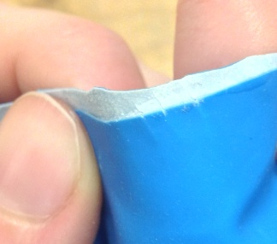
4. Granular Jamming Pad
Previous Design:
Reusable latex kitchen gloves secured into a palm shape using super glue
Design issues:
Super glue cracked, damaging the airtight seal
Granular jamming pad demonstrating cracking.

Slide 15
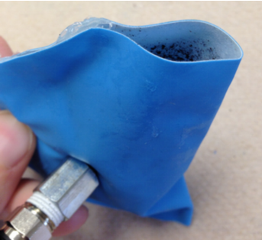
4. Granular Jamming Pad
New Design:
Reusable latex kitchen gloves secured into a palm shape using Loctite brand superflex silicone adhesive sealant
Pros:
Creates a better seal than super glue
Seal is flexible and will not crack
Cons:
Takes 24 hours to fully set
Creates thick, somewhat inflexible seams
Granular jamming pad sealed with silicone adhesive.

Slide 16
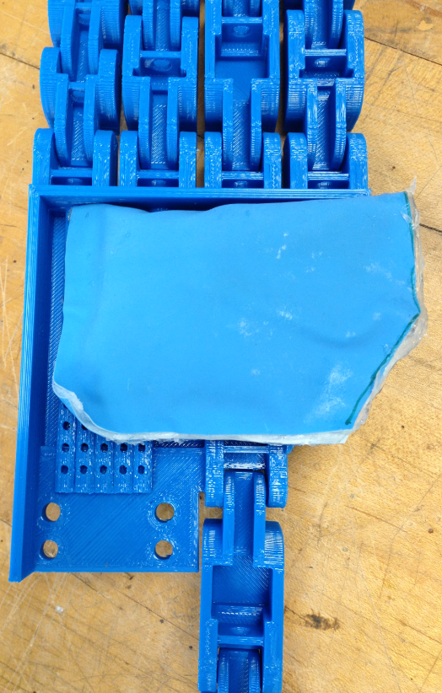
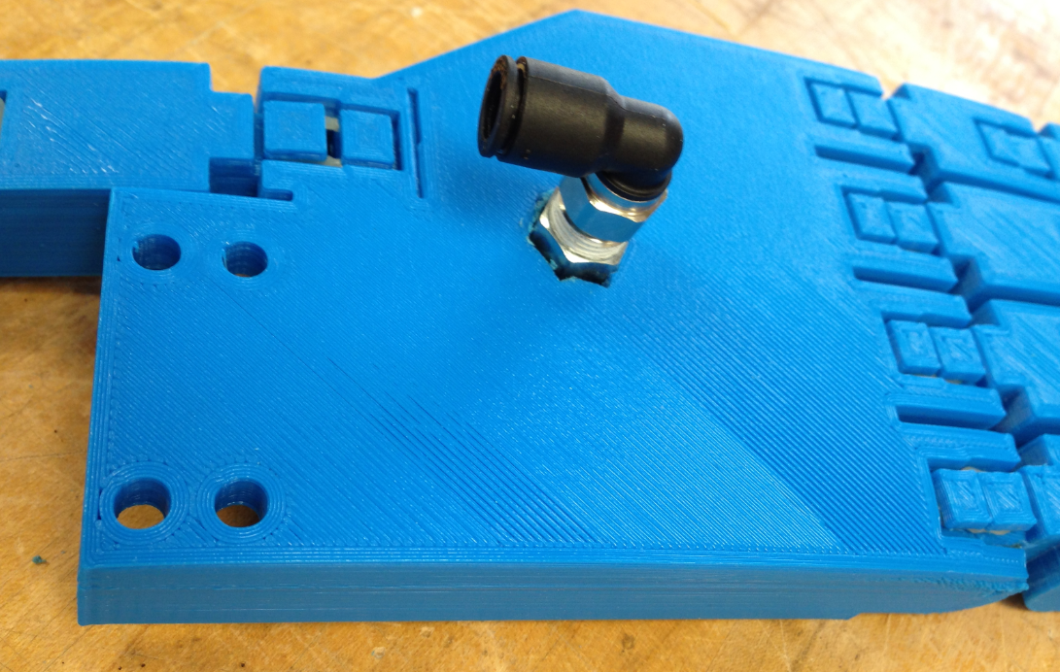
4. Granular Jamming Pad
Incorporation into the hand:

Slide 17
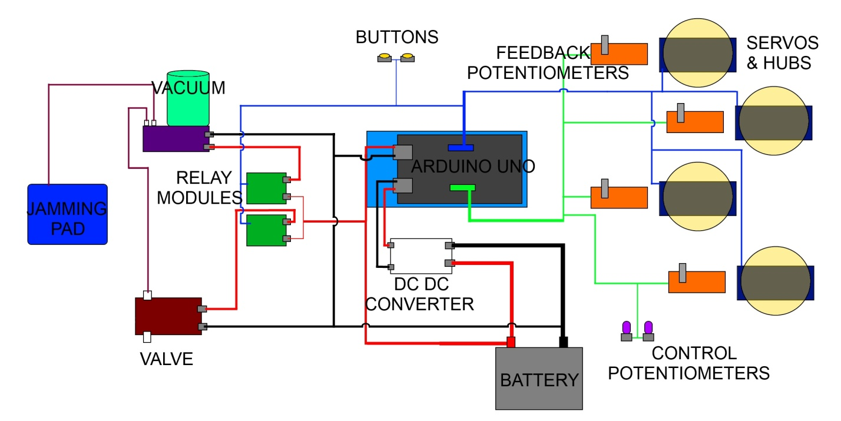
5. Electronics and Programming

Slide 18
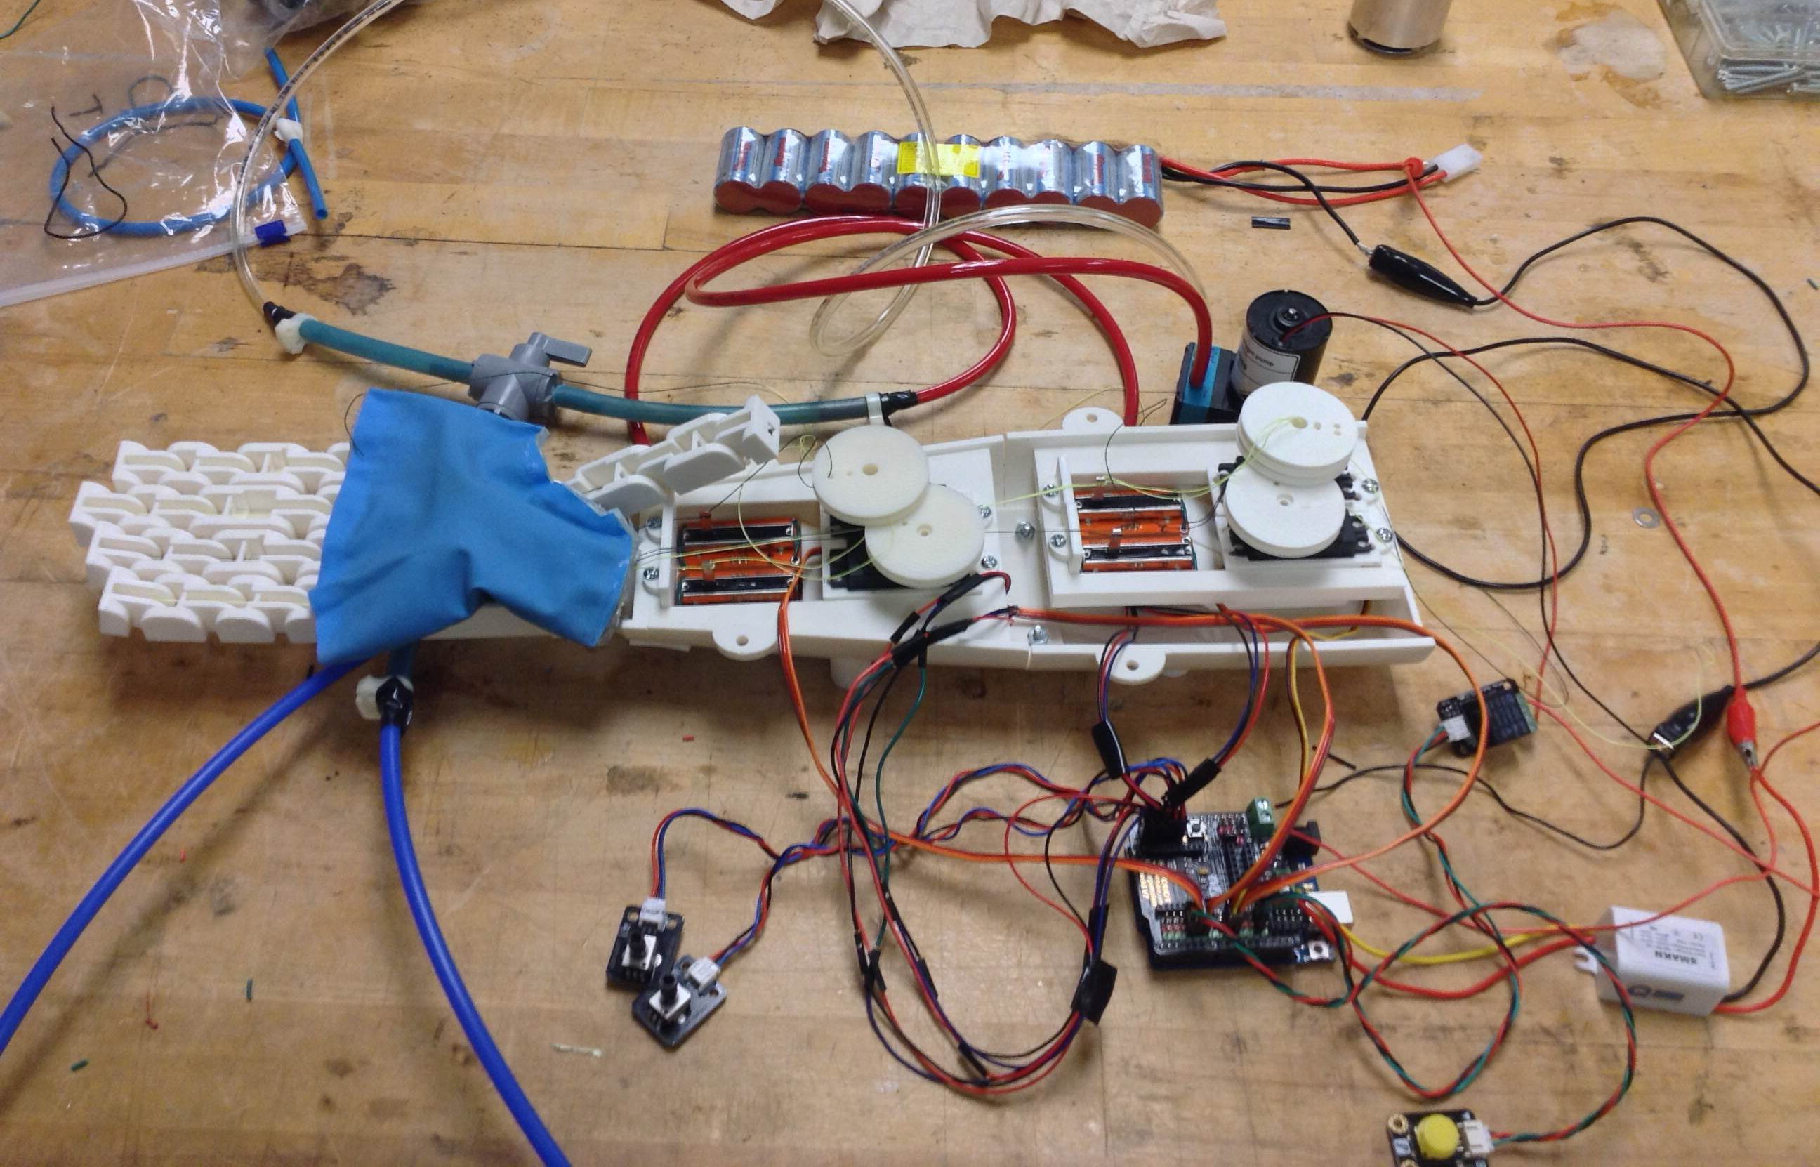
5. Electronics and Programming

Slide 19
5. Electronics and Programming
Program has changed
No longer MATLAB based
Arduino only
Control of vacuum with push button
Control of servos with rotary potentiometers
Linear potentiometers add capability to contour around slanted surfaces
Servos Move → check if potentiometers have updated
If Yes → move next step
If No → do not move

Slide 20
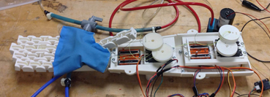
Prototype Fabrication
Fabrication steps are focused on simplicity
Assembly requires only screwdrivers and ABS cement
Hand is non-assembly, forearm is assembled in eight parts
Assembly instructions are provided on github
Instructions for pad, forearm, and hand assembly are all available
Electronics schematic is also available

Slide 21
Prototype Fabrication
Fabrication Steps:
Motors and sensors are secured into motor mounts
Motor mounts are dropped into forearm and bolted in
Hand is cabled and rubber bands are added
Hand is screwed to forearm
Granular jamming pad is secured to hand
Arduino is bolted to top half of forearm
Cables are run to motor hubs
Wiring is hooked up according to schematic
Forearm is bolted together

Slide 22
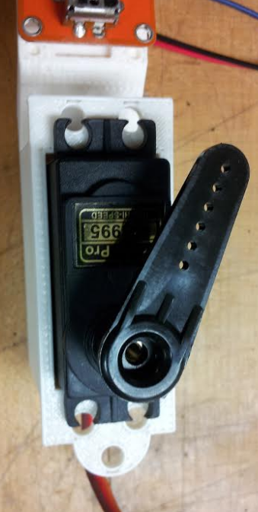
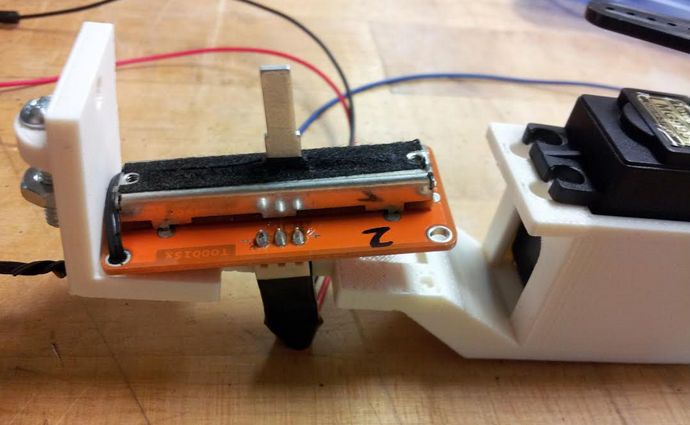
Problems in Fabrication
Potentiometers added friction
Solution: Extra rubber bands at finger bases
Mounts did not line up with servos
Fixed in the model but not the prototype
Printer did not print hand mount due to malfunction
Printed as a standalone hand mount and secured to arm via ABS cement
In general, very few assembly issues
This shows that the assembly is very straightforward and simple

Slide 23
Performance Testing
Finger range test
Actually limited slightly by length of potentiometers
Potentiometers also created additional friction
Sometimes caused the fingers to stay slightly curled when resting
Demo control
Showed functional contact detection
Established control of finger position
Granular jamming pad test
Showed that designed pad was slightly too stiff and shallow
Balloon latex proved to be a more effective material

Slide 24
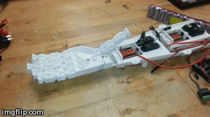
Performance Testing: Finger Range & Demo Control

Slide 25
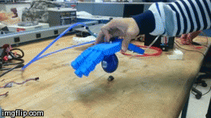
Performance Testing: Granular Jamming Pad

Slide 26
Additional Performance Testing
Unfortunately, due to an electrical short, this is where performance testing concluded
Additional tests that would have been conducted:
Finger strength
Close hand around objects of increasing weight, attempt to lift objects off table without fingers slipping
Finger dexterity
Close fingers around a non-uniformly shaped object
Success will be measured by how natural the grip appears, and how difficult it is to break grip and pull the object out of the hand
Potentiometer sensitivity
Close hand around a fragile object (such as a paper cup)
If fingers can close without crushing, test will be successful

Slide 27
Potential Improvements
Replace demo code with Bluetooth control
Additional updates to the forearm
Design in an open source program to make files easier to edit
Test print on a low-end printer without support material
Fit control elements more efficiently
Consider attachment to a person
Design 3D printed socket with customizable fit
Update granular jamming pad
Develop a pad with more depth
Utilize a more flexible housing material

Slide 28
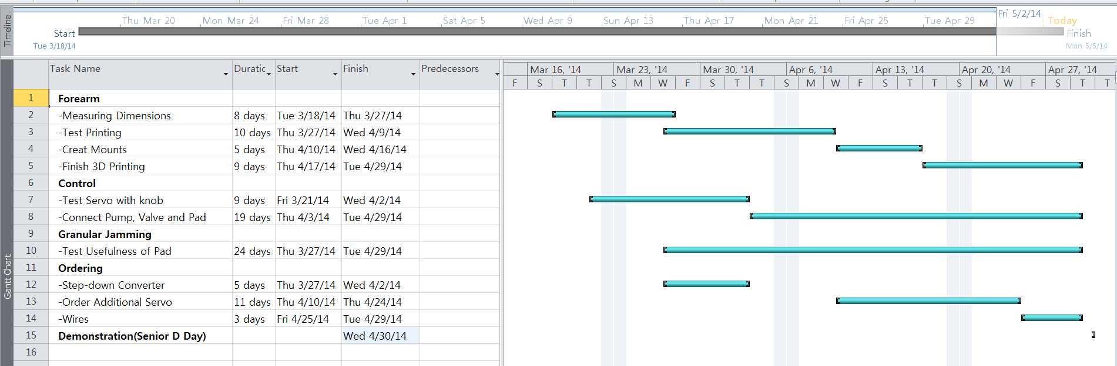
Gantt Chart

Slide 29
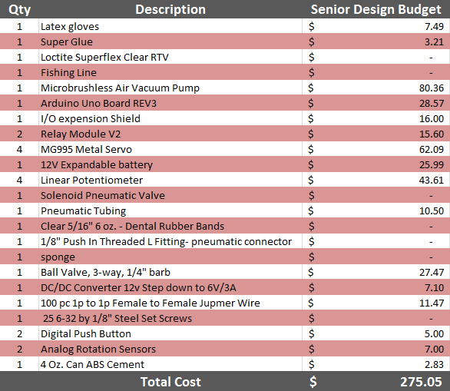
Budget
Budget as spent by the senior design team:

Slide 30
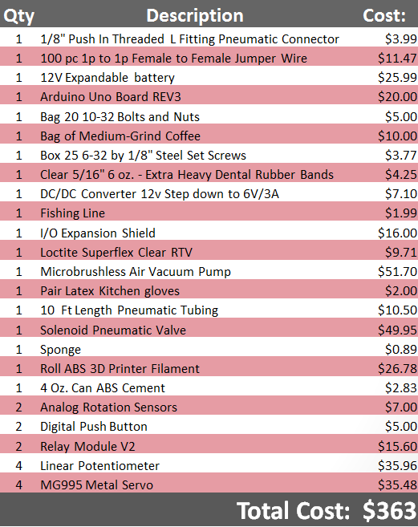
Budget
Budget for manufacture by an end user:

Slide 31
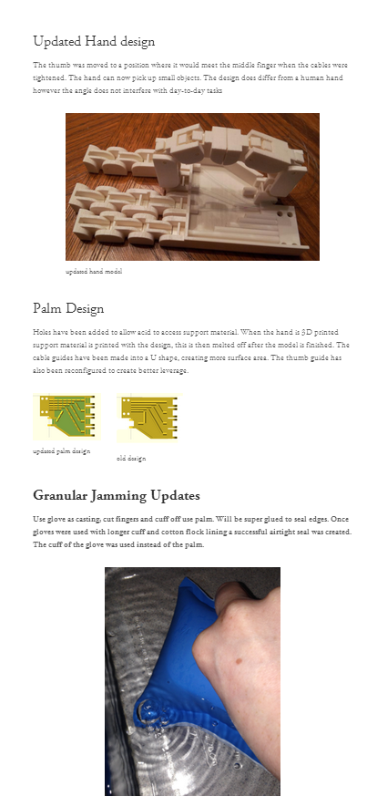
Website
Granular3dhand.squarespace.com
Project and team information
Provides blog-style project updates
Github.com/3D-Printed-Granular-Jamming-Hand
Provides source code and parts files
Full history of all file updates and changes

